Slide 1

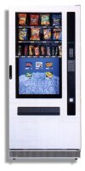
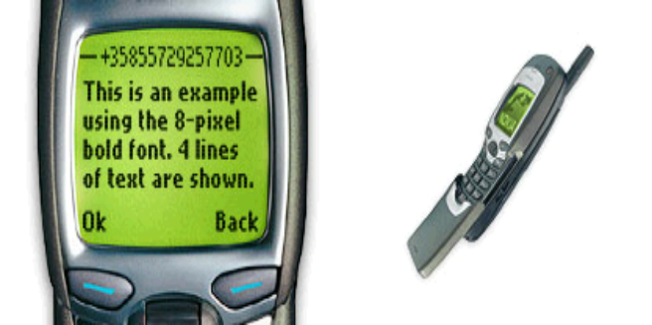
Understanding and conceptualizing interaction

Slide 2
Recap
HCI has moved beyond designing interfaces for desktop machines
About extending and supporting all manner of human activities in all manner of places
Facilitating user experiences through designing interactions
    Make work effective, efficient and safer
    Improve and enhance learning and training
    Provide enjoyable and exciting entertainment
    Enhance communication and understanding
    Support new forms of creativity and expression

Slide 3
Understanding the problem space
  What do you want to create?
  What are your assumptions?
  Will it achieve what you hope it will?

Slide 4
A framework for analysing the problem space
Are there problems with an existing product?
Why do you think there are problems?
Why do you think your proposed ideas might be useful?
How would you see people using it with their current way of doing things?
How will it support people in their activities?
Will it really help them?

Slide 5
An example
What were the assumptions made by cell phone companies when developing WAP services?
Was it a solution looking
for a problem?

Slide 6
Assumptions: realistic or wish-list?
People want to be kept informed of up-to-date news wherever they are - reasonable
People want to interact with information on the move - reasonable
People are happy using a very small display and using an extremely restricted interface - not reasonable
People will be happy doing things on a cell phone that they normally do on their PCs (e.g. surf the web, read email, shop, bet, play video games) - reasonable only for a very select bunch of users

Slide 7
From problem space to design space
Having a good understanding of the problem space can help inform the design space
  e.g. what kind of interface, behavior, functionality to provide
But before deciding upon these it is important to develop a conceptual model

Slide 8
Conceptual model
Need to first think about how the system will appear to users (i.e. how they will understand it)
A conceptual model is a high level description of:
  “the proposed system in terms of a set of integrated ideas and concepts about what it should do, behave and look like, that will be understandable by the users in the manner intended”

Slide 9
First steps in formulating a conceptual model
What will the users be doing when carrying out their tasks?
How will the system support these?
What kind of interface metaphor, if any, will be appropriate?
What kinds of interaction modes and styles to use?
  Always keep in mind when making design decisions how the user will understand the underlying conceptual model

Slide 10
Conceptual models
Many kinds and ways of classifying them
Here we describe them in terms of core activities and objects
Also in terms of interface metaphors

Slide 11
Conceptual models based on activities
Giving instructions
  issuing commands using keyboard and function keys and selecting options via menus
Conversing
  interacting with the system as if having a conversation
Manipulating and navigating
  acting on objects and interacting with virtual objects
Exploring and browsing
  finding out and learning things

Slide 12
1. Giving instructions
Where users instruct the system and tell it what to do
  e.g. tell the time, print a file, save a file
Very common conceptual model, underlying a diversity of devices and systems
  e.g. CAD, word processors, VCRs, vending machines
Main benefit is that instructing supports quick and efficient interaction
  good for repetitive kinds of actions performed on multiple objects

Slide 13
2. Conversing
Underlying model of having a conversation with another human
Range from simple voice recognition menu-driven systems to more complex ‘natural language’ dialogues
Examples include timetables, search engines, advice-giving systems, help systems
Recently, much interest in having virtual agents at the interface, who converse with you, e.g. Microsoft’s Bob and Clippy

Slide 14
Pros and cons of conversational model
Allows users, especially novices and technophobes, to interact with the system in a way that is familiar
  makes them feel comfortable, at ease and less scared
Misunderstandings can arise when the system does not know how to parse what the user says
  e.g. child types into a search engine, that uses natural language the question:
  “How many legs does a centipede have?” and the system responds:

Slide 15
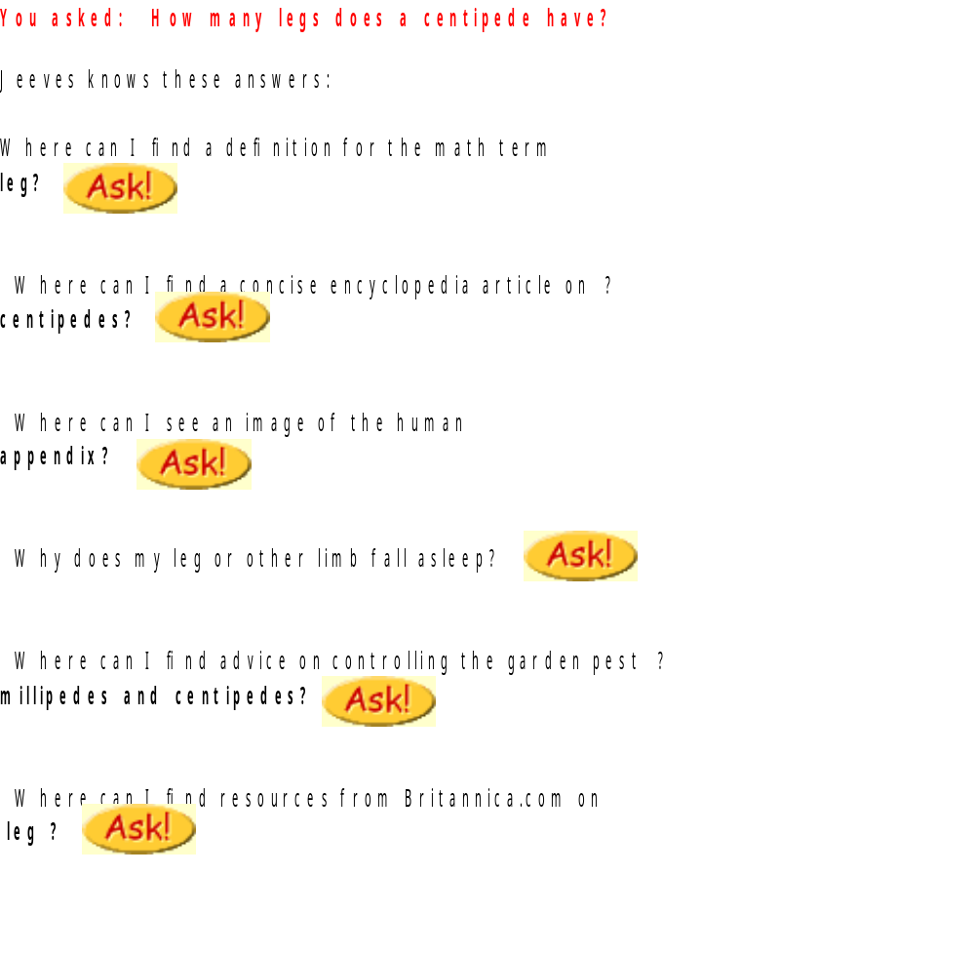

Slide 16
3. Manipulating and navigating
Involves dragging, selecting, opening, closing and zooming actions on virtual objects
Exploit’s users’ knowledge of how they move and manipulate in the physical world
Exemplified by (i) what you see is what you get (WYSIWYG) and (ii) the direct manipulation approach (DM)
Shneiderman (1983) coined the term DM, came from his fascination with computer games at the time

Slide 17
Core principles of DM
Continuous representation of objects and actions of interest
Physical actions and button pressing instead of issuing commands with complex syntax
Rapid reversible actions with immediate feedback on object of interest

Slide 18
Why are DM interfaces so enjoyable?
Novices can learn the basic functionality quickly
Experienced users can work extremely rapidly to carry out a wide range of tasks, even defining new functions
Intermittent users can retain operational concepts over time
Error messages rarely needed
Users can immediately see if their actions are furthering their goals and if not do something else
Users experience less anxiety
Users gain confidence and mastery and feel in control

Slide 19
What are the disadvantages with DM?
Some people take the metaphor of direct manipulation too literally
Not all tasks can be described by objects and not all actions can be done directly
Some tasks are better achieved through delegating
  e.g. spell checking
Can become screen space ‘gobblers’
Moving a mouse around the screen can be slower than pressing function keys to do same actions

Slide 20
4. Exploring and browsing
Similar to how people browse information with existing media (e.g. newspapers, magazines, libraries, pamphlets)
Information is structured to allow flexibility in way user is able to search for information
  e.g. multimedia, web

Slide 21
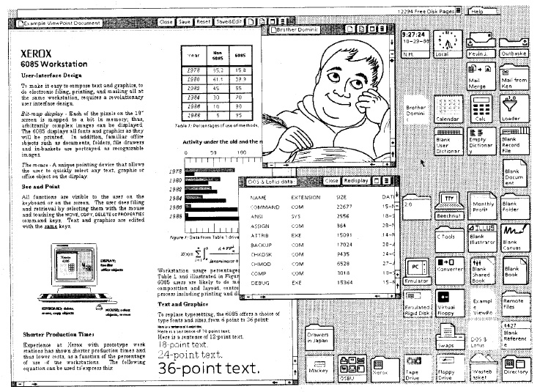
Conceptual models based on objects
Usually based on an analogy with something in the physical world
Examples include books, tools, vehicles
Classic: Star Interface
based on office
objects
Johnson et al (1989)

Slide 22
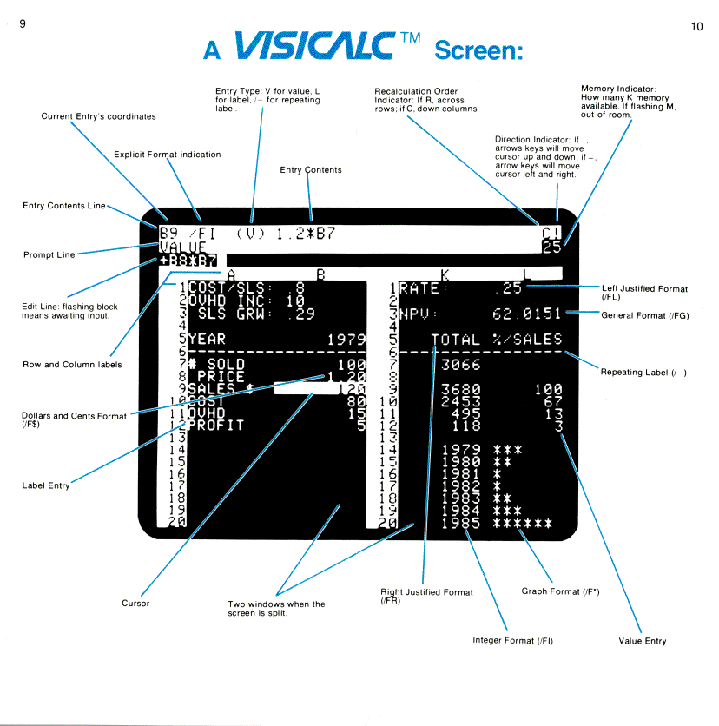
Another classic: the spreadsheet (Bricklin)
Analogous to ledger
sheet
Interactive and
computational
Easy to understand
Greatly extending
what accountants
and others could do
www.bricklin.com/history/refcards.htm

Slide 23
Which conceptual model is best?
Direct manipulation is good for ‘doing’ types of tasks, e.g. designing, drawing, flying, driving, sizing windows
Issuing instructions is good for repetitive tasks, e.g. spell-checking, file management
Having a conversation is good for children, computer-phobic, disabled users and specialised applications (e.g. phone services)
Hybrid conceptual models are often employed, where different ways of carrying out the same actions is supported at the interface - but can take longer to learn

Slide 24
Interface metaphors
Interface designed to be similar to a physical entity but also has own properties
  e.g. desktop metaphor, web portals
Can be based on activity, object or a combination of both
Exploit user’s familiar knowledge, helping them to understand ‘the unfamiliar’
Conjures up the essence of the unfamiliar activity, enabling users to leverage of this to understand more aspects of the unfamiliar functionality

Slide 25
Benefits of interface metaphors
Makes learning new systems easier
Helps users understand the underlying conceptual model
Can be very innovative and enable the realm of computers and their applications to be made more accessible to a greater diversity of users

Slide 26
Problems with interface metaphors
Break conventional and cultural rules
  e.g. recycle bin placed on desktop
Can constrain designers in the way they conceptualize a problem space
Conflict with design principles
Forces users to only understand the system in terms of the metaphor
Designers can inadvertently use bad existing designs and transfer the bad parts over
Limits designers’ imagination in coming up with new conceptual models

Slide 27
Conceptual models: from interaction mode to style
Interaction mode:
  what the user is doing when interacting with a system, e.g. instructing, talking, browsing or other
Interaction style:
  the kind of interface used to support the mode, e.g. speech, menu-based, gesture

Slide 28

Many kinds of interaction styles available…
Command
Speech
Data-entry
Form fill-in
Query
Graphical
Web
Pen
Augmented reality
Gesture and even...

Slide 29
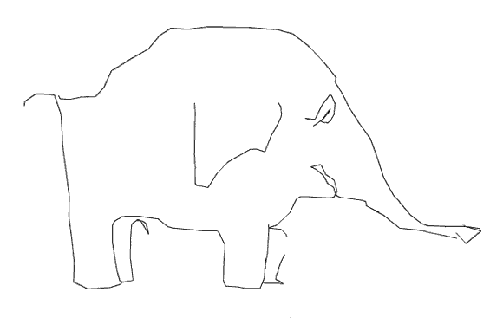
Interacting via GPRS enabled cell phone…
Drawing an elephant by walking round the streets of a city (or other mode of transport) and entering data points along the way via the cell phone
Example: Brighton and Hove(UK) by J. Wood by foot, track length 11.2km (see www.gpsdrawing.com for more examples)

Slide 30
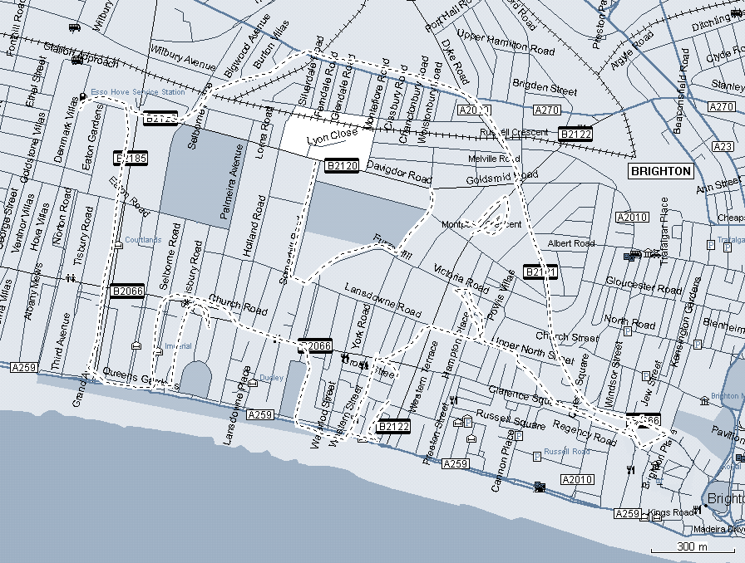
Making art by recording where walking in a city

Slide 31
Which interaction style to choose?
Need to determine requirements and user needs
Take the budget and other constraints into account
Also will depend on suitability of technology for activity being supported
This topic will be covered more later when discuss how to actually design conceptual models

Slide 32
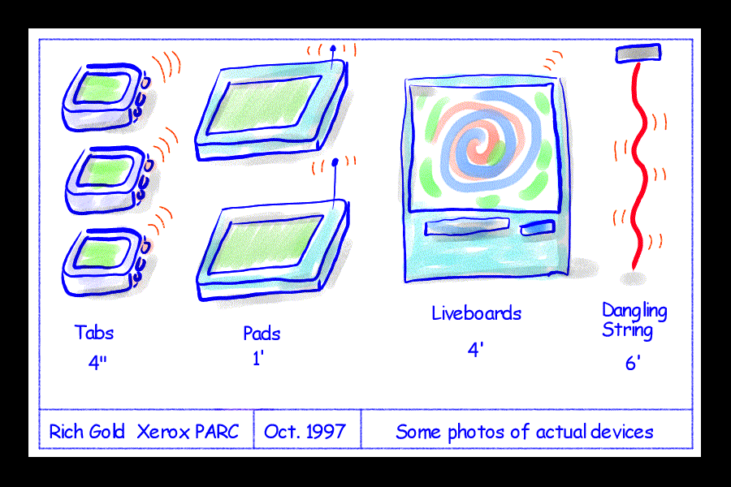
Interaction paradigms
Another form of inspiration for conceptual models
From the desktop to ubiquitous computing
(embedded in the
environment)

Slide 33
Examples of new paradigms
Ubiquitous computing (mother of them all)
Pervasive computing
Wearable computing
Tangible bits, augmented reality
Attentive environments
Transparent computing
  and many more….

Slide 34
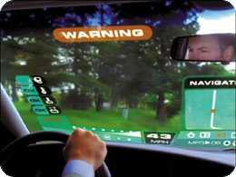
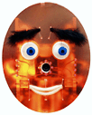
Two examples: BlueEyes (IBM) and Cooltown (HP)
Visionary approaches for developing novel conceptual paradigms
Almalden.ibm.com/cs/blueeyes/
cooltown.hp.com/mpulse/backissues/0601/0601-cooltown.asp

Slide 35
Summary points
Important to have a good understanding of the problem space
Fundamental aspect of interaction design is to develop a conceptual model
Interaction modes and interface metaphors provide a structure for thinking about which kind of conceptual model to develop
Interaction styles are specific kinds of interfaces that are instantiated as part of the conceptual model
Interaction paradigms can also be used to inform the design of the conceptual model

